Slide 1
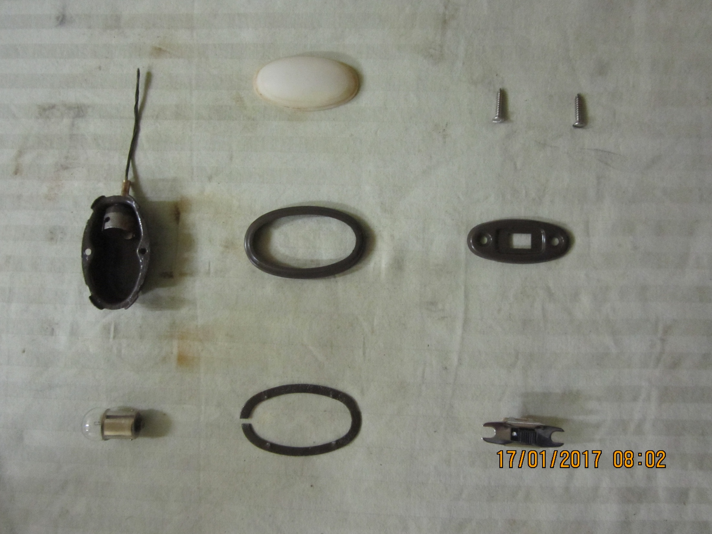
78-13783
(dome lamp plastic lens)
33000-S13
(screw #6 x 3/4”)
(dome lamp housing)
78-13788
(dome lamp door Rustic Brown)
78-13770
(switch escutcheon-Rustic Brown)
B-13799
(dome lamp bulb 15 CP)
78-13784
(dome lamp lens retainer)
B-13752A
(dome lamp switch)

Slide 2
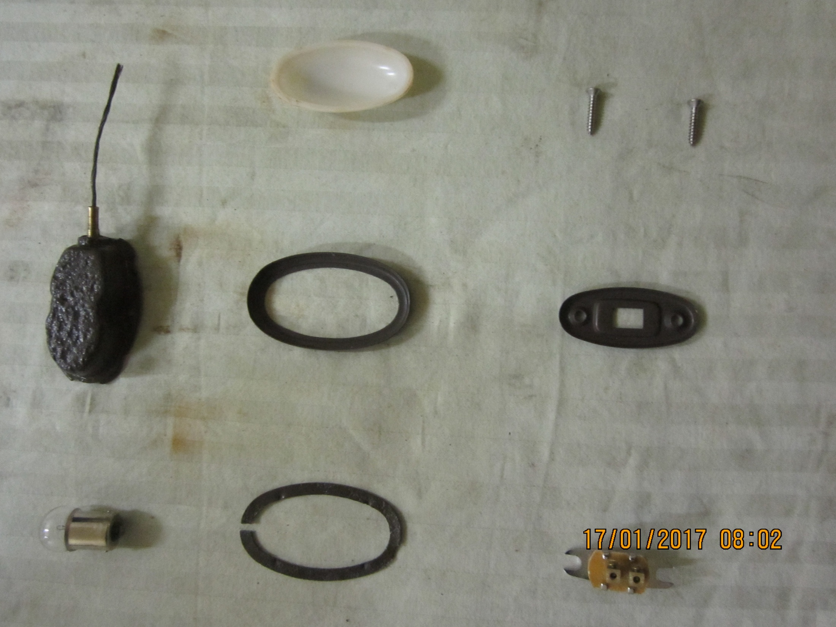
78-13783
(dome lamp plastic lens)
33000-S13
(screw #6 x 3/4”)
(dome lamp housing)
78-13788
(dome lamp door Rustic Brown)
78-13770
(switch escutcheon-Rustic Brown)
B-13799
(dome lamp bulb 15 CP)
78-13784
(dome lamp lens retainer)
B-13752A
(dome lamp switch)

Slide 3
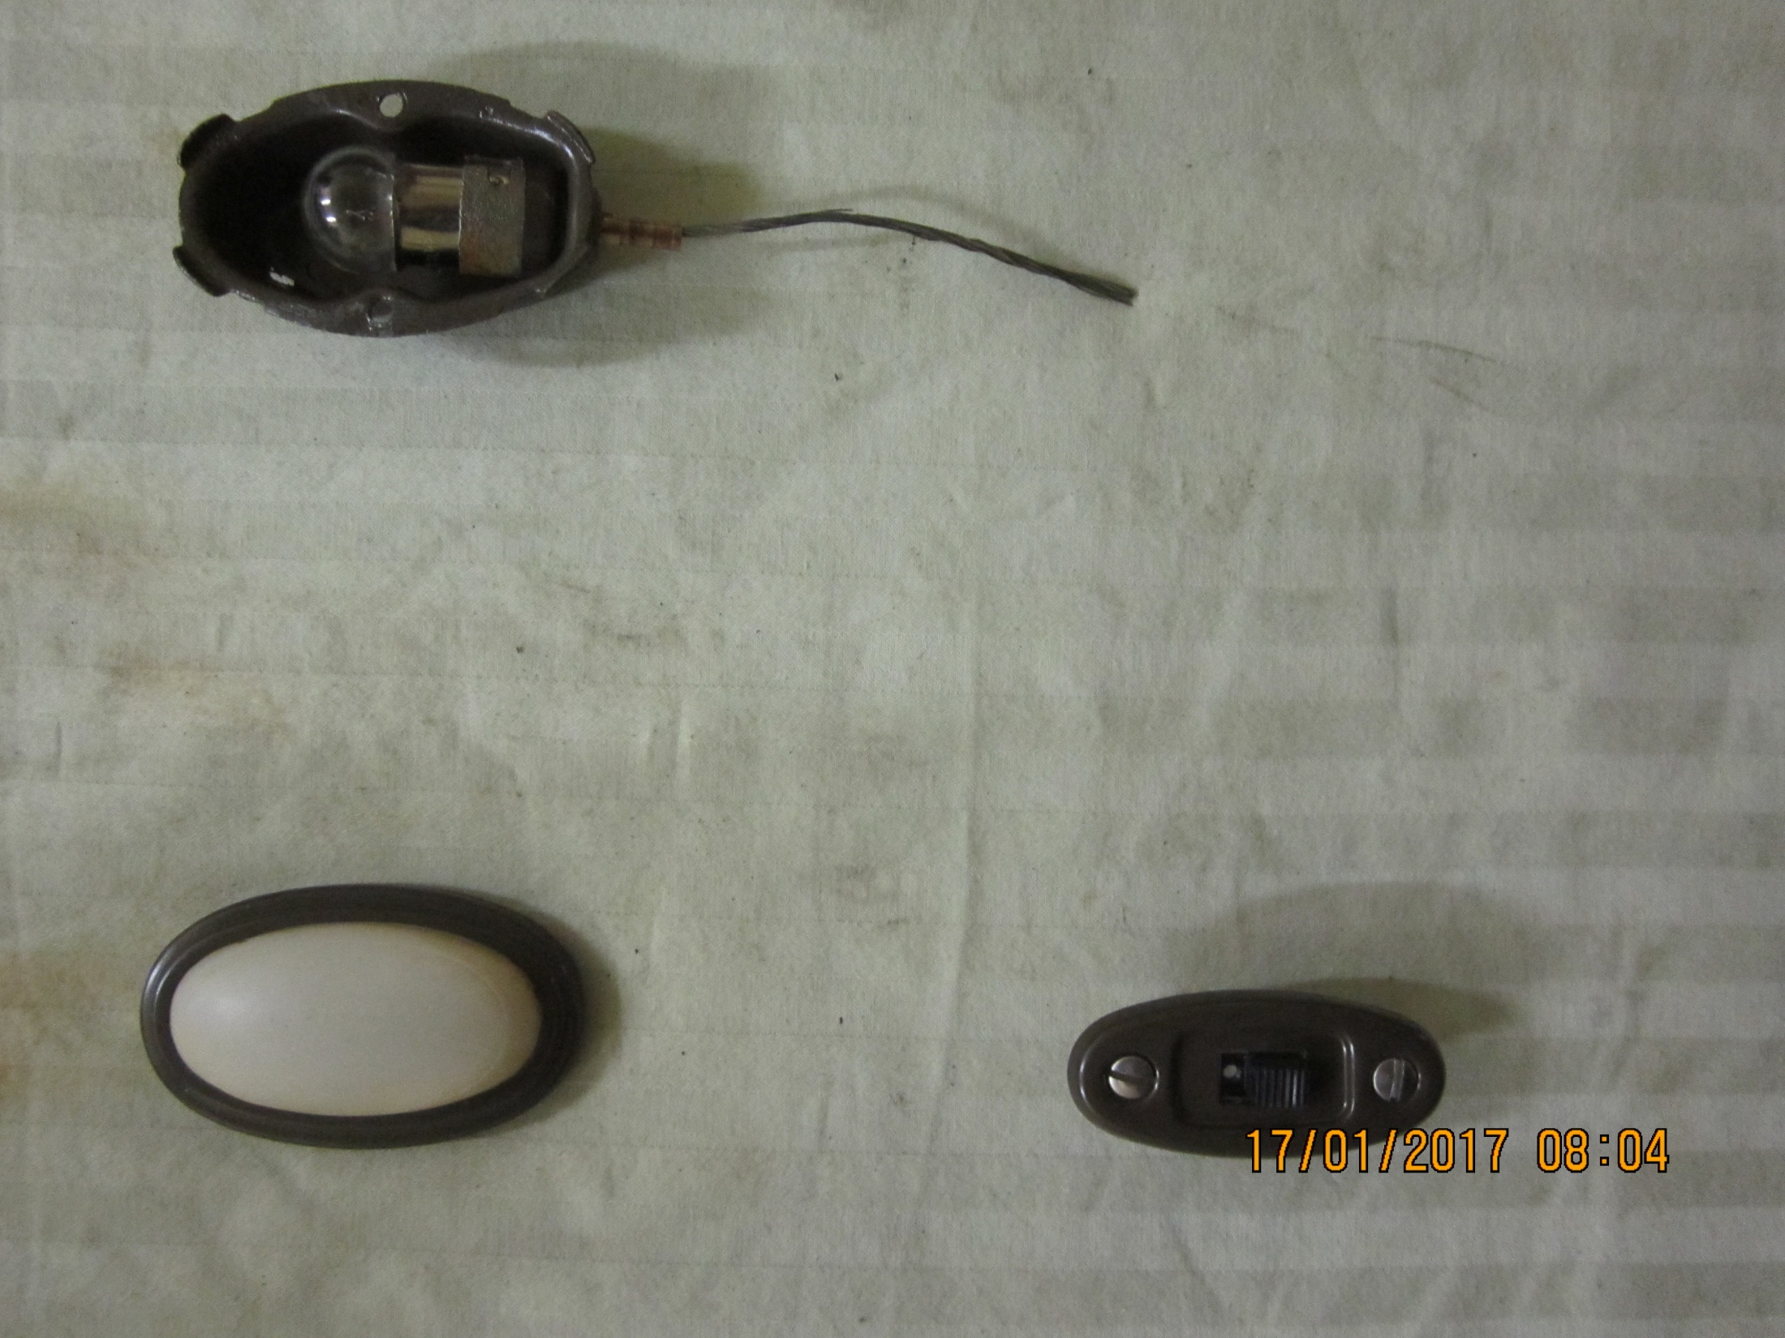
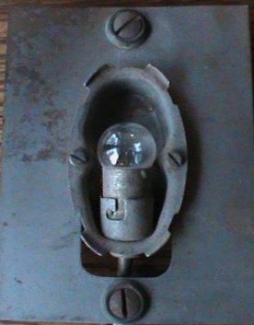
(dome lamp housing & bulb)
78-785026
(dome lamp attach plate) AHT101
(shown with lamp housing)
78-13779
(door & lens assembly) CPL-123
(dome switch assembly)

Slide 4
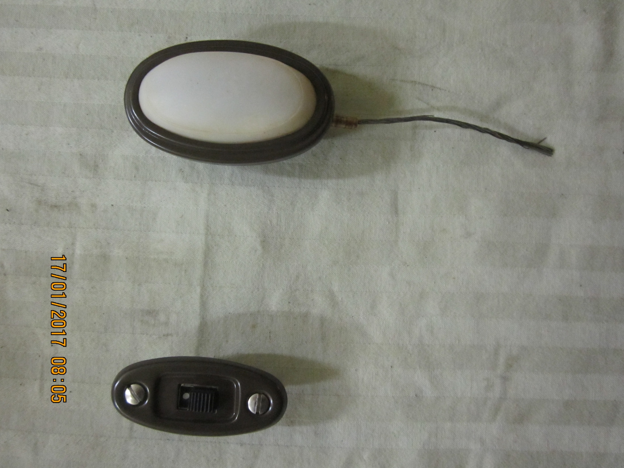
78-13777
(dome lamp full assembly)
(dome lamp switch full assembly)

